Slide 1
Date:
8.29.14 A
9.2.14 B
How do we read, interpret and analyze information on maps?
How to Read a Map
Class Work:
Warm Up: What is the purpose of a map? What can maps tell us? What kinds of maps are you familiar with?
Geography Pre-Assessment
Review the Warm-Up
Map Information Notes
Map Activity
WIO/Closure
HW: Latitude & Longitude Worksheet
WIO: In complete sentences, write down the most important thing you learned about looking at maps today and explain why it is important?
Page 2
Page 3

Slide 2
Geography Pre-Assessment
THIS IS NOT FOR A GRADE!
This is to see what you already know.
This is a class set of the Pre-Assessment
DO NOT WRITE ON IT!
Answer Each question on a separate sheet of paper.
When you are done, turn your paper over so I know you have finished.

Slide 3
Pre-Assessment Answers
Antarctica
Atlantic Ocean
Asia
North America
Pacific Ocean
6. South America
7. Indian Ocean
8. Arctic Ocean
9. Africa
10. Australia
11. Europe

Slide 4
Pre-Assessment Answers
12. Latitude
13. Longitude
14. Equator
15. Prime Meridian

Slide 5
Map Video
We will be watching a video which discusses maps.
Pay attention to the different types of maps as they will be helpful with the activity we will be working on later.
Try to answer the questions that the video will ask.

Slide 6
Maps & Their Parts

Slide 7
What is a map?
It is a representation of an area of land or sea showing physical features, cities, roads, etc.

Slide 8
Uses of Maps
To determine where you are going.
To act as a model of Earth’s surface.
Used to locate various places
To show the distribution of various features or types of materials.

Slide 9
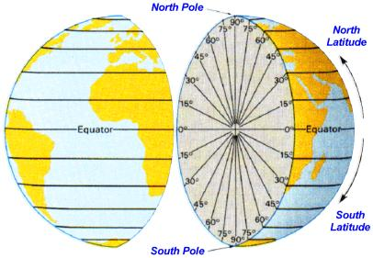
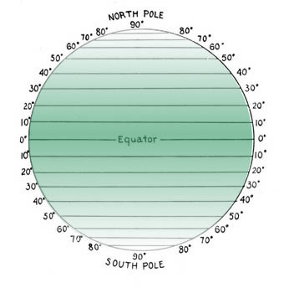
Quick Review of Latitude and Longitude
Latitude
Measured in degrees North and South of the Equator.
Lines drawn parallel to each other running west to east.
The Equator marks Zero Degrees➔ North & South

Slide 10
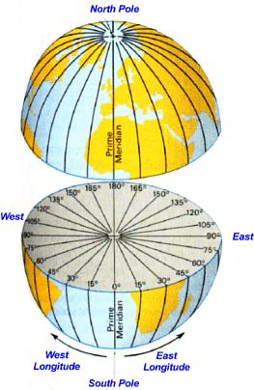
Quick Review of Latitude and Longitude
Longitude
Measured in degrees East or West of the prime meridian.
Lines drawn running North and South.
The Prime Meridian marks Zero Degrees➔ East & West

Slide 11
Parts of a Map

Slide 12
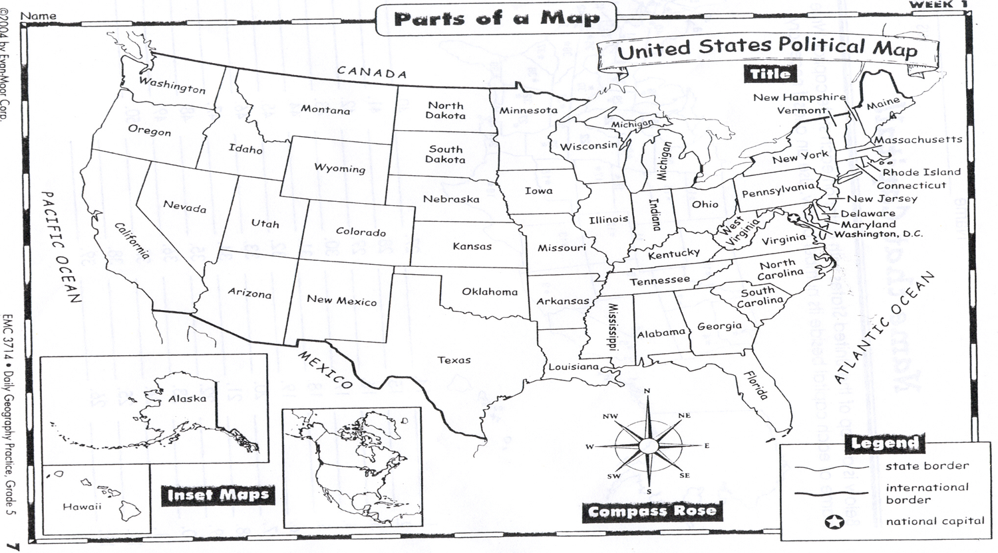
The Title➔ Describes the map

Slide 13
Compass Rose➔ Tells you the proper direction

Slide 14
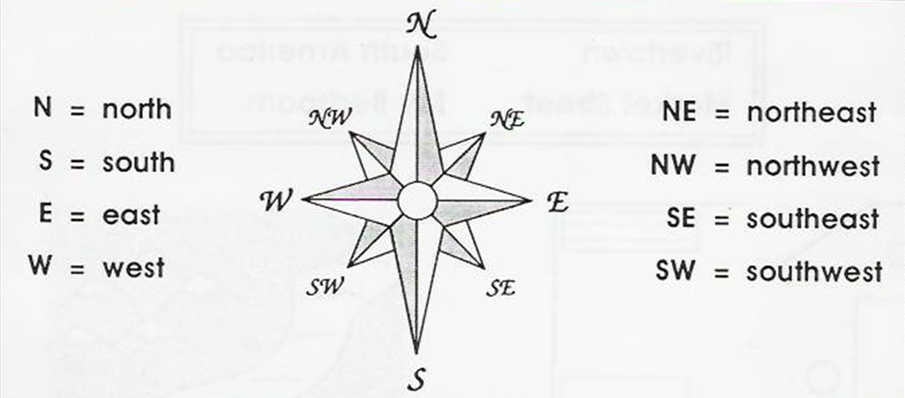

Slide 15
Legend➔ Shows what symbols are for

Slide 16
Inset Map➔ Shows additional features

Slide 17
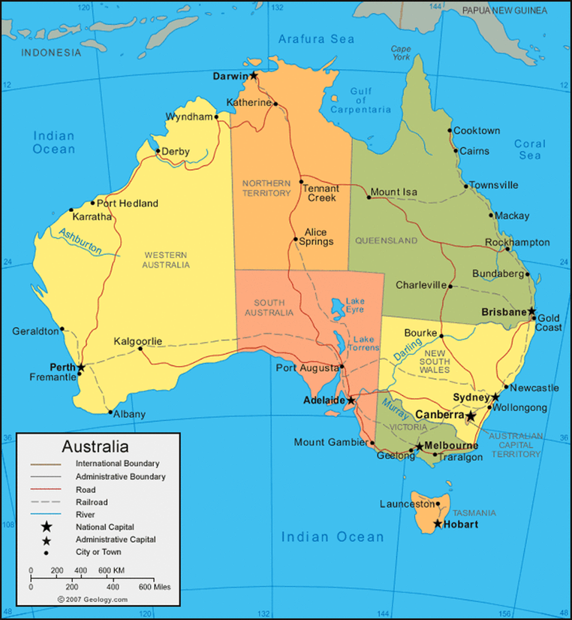
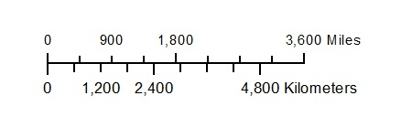
Scale➔ Shows the Size Ratio of the Map

Slide 18
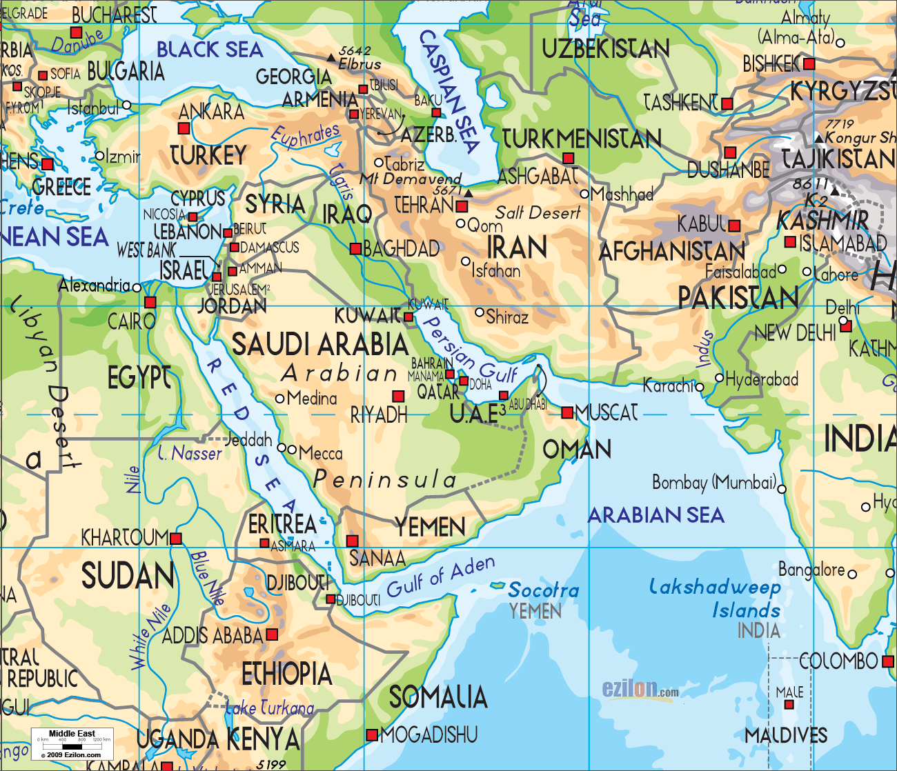
Physical Map
Shows country borders, major cities and significant bodies of water, physical maps indicate the location of landforms like deserts, mountains and plains.

Slide 19
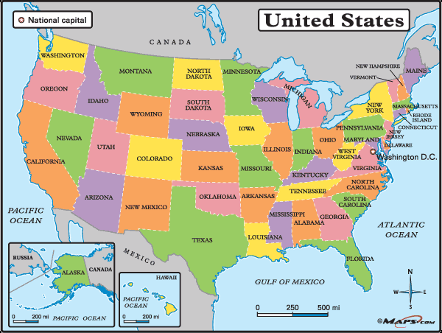
Political Map
Are designed to show governmental boundaries of countries, states and counties. They can also indicate the location of major cities, and they usually include significant bodies of water.

Slide 20
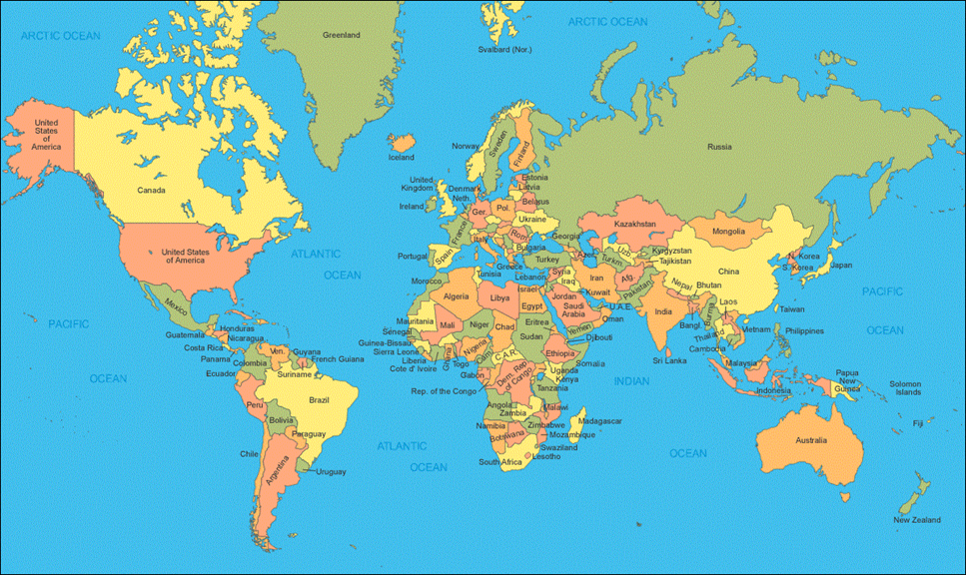

Slide 21
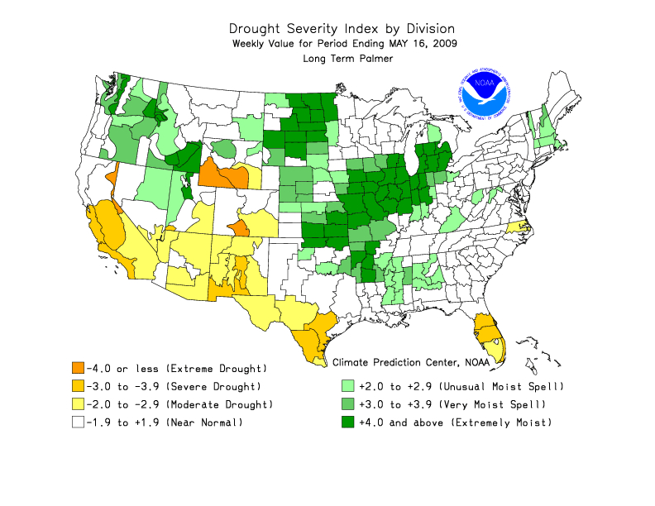
Thematic Map
A thematic map is a type of map or chart especially designed to show a particular theme connected with a specific geographic area.
These maps "can portray physical, social, political, cultural, economic, sociological, agricultural, or any other aspects of a city, state, region, nation, or continent".

Slide 22
Map Activity
You will be looking at maps and answering the questions on the right side of the work sheet.
All questions must be answered in complete sentences.
You will be working in your groups to answer the questions.
When I say go, you will have 10 minutes to complete this task.

Slide 23
WIO
In complete sentences, write down the most important thing you learned about looking at maps today and explain why it is important?

